Slide 1
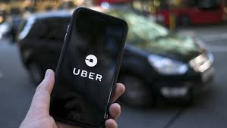
Uber Supply-demand Gap Analysis
By:-
BiSWAJIT KUMAR sINGH

Slide 2
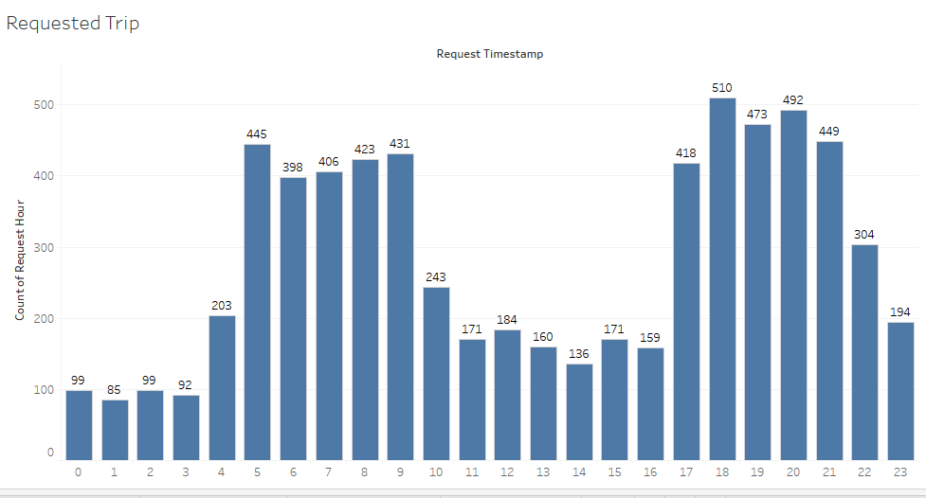
The Time between 5am to 9 am and from 5Pm to 10Pm request of car are more from airport to city and vice versa.

Slide 3
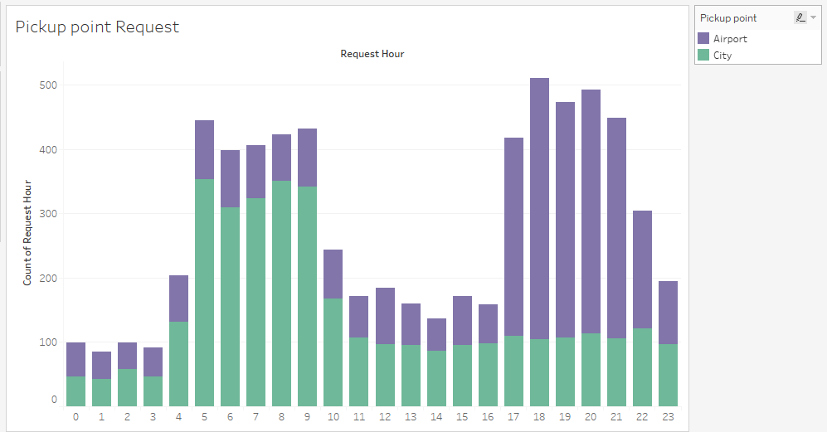
* From Airport to city Request of car are more in the evening hours(5pm to 9 pm). * From City to airport The requested of car are more from in the morning time (5am to 9 am).

Slide 4
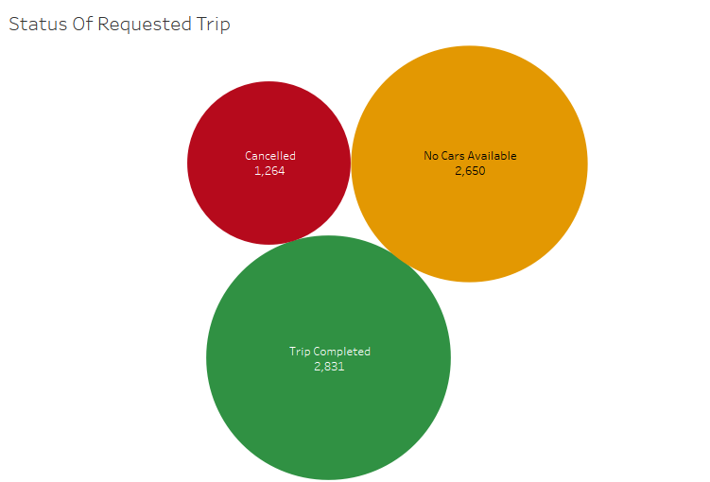
As Per the user requested for the uber the details of number of trip completed ,no car available and cancelled status .

Slide 5
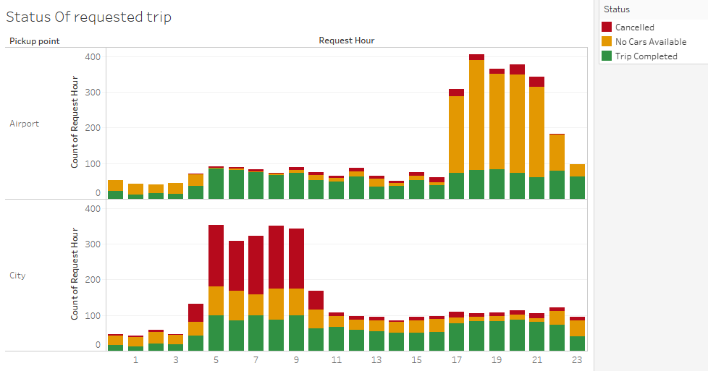
From The airport The Number of car unavailable more in the evening time From the city the number of car cancelled more from the driver in the morning time.

Slide 6
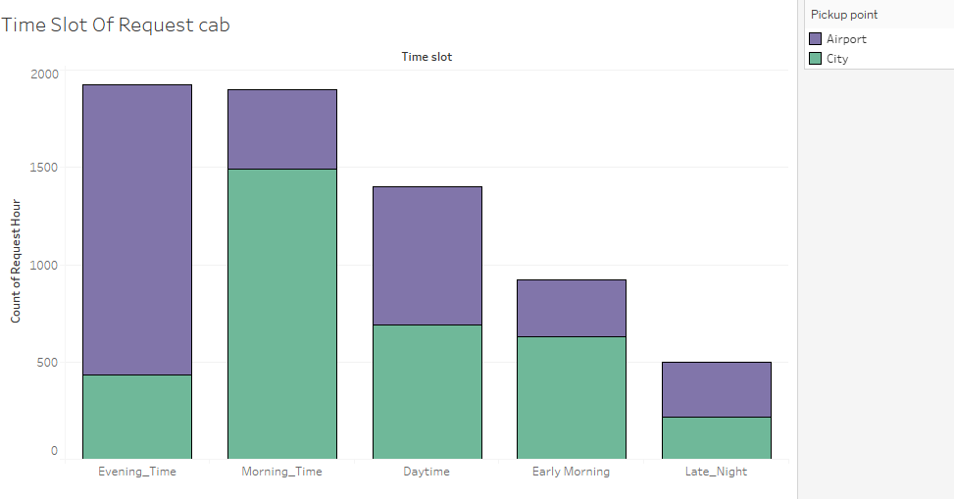
From the time slot graph evening time the request of the car is more in airport From the time slot graph morning time the request of car is more in city.

Slide 7
Problem Solutions:-
From Airport to city:-
(*)An Uber stand can be created at Airport where Cabs will available all the time, this will itself lower down the No Cars Available status.
From City to Airport:-
(*) Uber can give some small reward or something to the drives in the morning. This might attract drivers to go for Airport, this step can be helpful in reducing the number of cancellation during morning time for Airport.
(*) Penalty for driver cancelling Airport booking thrice a day, it will reduce the cancellation of rides from city to airport in the morning time.
(*) There is definitely need of more cars for filling the Gap.

